Slide 2
PAYMENT RECLAIMS (1099 OID)
Recycling currency to your advantage.

Slide 3






Disclaimer
We have no legal training or qualifications, and are not legal advisors
This recording is for entertainment purposes only
We cannot be held responsible for errors or omissions
We do not provide regulated financial services, activities or advice
Do your own research and be diligent
All rights reserved

Slide 4
Contents
No Lawful Money
What is a security?
Private bankers
Return to source
Law of salvage
Abandonment
Claim criteria
Working example
Recent success – the proof!
Expectations
Rewards
Getting started

Slide 5

1. No Lawful Money
THERE IS NO MONEY OF SUBSTANCE
Bankruptcy Acts, Federal Reserve Act 1913, The Gold Standard (Amendment) Act 1931, HJR 192 5th June 1933
Fiat by Decree
The banks do not LEND you anything! Everything operates in Bankrupt-sea!
Promises to pay [Bills of Exchange Act 1882], commercial paper
All transactions are securities - and an elaborate illusion!
Notes:
Since its foundation in 1694 the Bank of England (the ‘Bank’) has issued notes promising to pay the bearer a sum of money. For much of its history the promise could be made good by the Bank paying out gold in exchange for its notes. The link with gold helped to maintain the value of the notes, although the link was sometimes suspended, for example in wartime.
The link with gold was finally broken in 1931 (see in particular The Currency and Bank Notes Act 1928 and The Gold Standard (Amendment) Act 1931) when the UK came off the gold standard, and since that time there has been no other asset into which holders have the right to convert Bank of England notes. They can only be exchanged for other Bank of England notes. Nowadays public faith in the pound is maintained in a different way - through the Bank of England's operation of monetary policy, the object of which, by statute, is price stability.
The Bank Charter Act 1844 and the Currency and Bank Notes Acts 1928 and 1954, provide for the establishment of a distinct Department within the Bank of England - the Issue Department – and for the issue of banknotes. This legislation also requires notes issued by the Bank to be backed by securities (the concept of securities was broadened by the Finance Act 1932 and is now reflected in the amended 1928 Act) held in the Issue Department and confers legal tender status on Bank of England notes.

Slide 6
2. What is a Security?
Blacks Law Dictionary, 9th Ed:
  Collateral given or pledged to guarantee the fulfilment of an obligation; esp., the assurance that a creditor will be repaid (usu. with interest) any money or credit extended to a debtor.
Frederick Stroud, The Judicial Dictionary (2nd ed. 1903)
  A " Security," speaking generally, is anything that makes the money more assured in its payment or more readily recoverable; as distinguished from e.g. a mere I. 0. U. which is only evidence of a debt. Thus, Bank Notes, Bills of Exchange, Promissory Notes, and Cheques, are " Securities " (Byles, V. espy Preface to 1 ed.)

Slide 7
3. Private Bankers
OPERATING THE PERSON
We are the AGENT for the strawman, bringing it to life
Our actions bind it in the game of monopoly
Bank Charter Act 1844, s.28:
  “the term “Bank of England notes” shall extend and apply to the promissory notes of the Bank of England payable to bearer on demand; and the term “banker” shall extend and apply to all corporations, societies, partnerships, and persons, and every individual person, carrying on the business of banking, whether by the issue of bank notes or otherwise, except only the Bank of England; and the word “person” used in this Act shall include corporations;
Notes:
The Taxman is not the ONLY tax-man on the block!
The Taxman is unaware of all the details regarding private contracts created because:
Banks don’t disclose all the details
Banks operate 2 sets of books – disguised as PUBLIC and Private

Slide 8

4. Return to source
DUST TO DUST
MAXIM: He who creates owns!
In nature: water, consciousness, the cycle of life (as above, so below)
Mercantile Law Amendment Act 1856, s.5: “a surety who discharges the liability to be entitled to assignment of all securities held by the creditor”
Notes:
When You Make Your Claim You Will Be Claiming EVERYTHING that has passed Through Your Bank Account and or Credit Card into that SYSTEM.
Each debit is a NEW SECURITY
You Created it
You are the Creator
You are the Original Issuer
You are the Alpha and Omega
Everything Returns to Source

Slide 9
5. Law of Salvage
MARITIME
The law of admiralty for almost 3,000 years has uniformly held that those who voluntarily come to the assistance of fellow seamen in distress and perform salvage are entitled to be rewarded
Customs Consolidation Act 1876, s.165
  “all bonds and other securities entered into by any person or persons for the performance of any condition, order, or matter relative to the Customs or incident thereto shall be valid in law, and upon breach of any of the conditions thereof may be sued and proceeded upon in the same manner as any bond expressly directed or given by or under the provisions' of the Customs Acts ; and all bonds relating to the Customs, or for the performance of any condition or matter incident thereto, shall be taken to or for the use of Her Majesty; and all such bonds, except such as are given for securing the due exportation of or payment of duty upon warehoused goods, may, after the expiration of three years from the date thereof, or from the time, if any, limited therein for the performance of the condition thereof, be cancelled, by or by the order of the Commissioners of Customs; and all bonds given under the provisions of the Customs Acts by persons under twenty-one years of age shall be valid.

Slide 10
6. Abandonment
IS IT YOUR INTENT?
Blacks Law (9th Ed): “the relinquishing of a right or interest with the intention of never reclaiming it”
Blacks Law (1st Ed): “the surrender, relinquishment, disclaimer, or cession of property or of rights. The giving up a thing absolutely, without reference to any particular person or purpose; as throwing a jewel into the highway; leaving a thing to itself, desertion, dereliction”
In French law (Merl. Report): “the act by which a debtor surrenders his property for the benefit of his creditors”

Slide 11

7. Claim criteria
A MEMBERS BENEFIT
Only available to those on PAID memberships
Not available to members who have requested a refund since July 2022
One claim per year (total 3 years, currently 2019), by 31 Jan 2023
Not available if you have filed a 1040 for the year
Accounts can be open or closed (incl. bank accounts and credit cards)
Accounts can be in joint names: only one claimant
Must be a member of a jurisdiction in which the IMF operates

Slide 12
8. Working example
 |  | Year 1 | Year 2 | Year 3 | Year 4 | Year 5 | Year 6 |  | Total Claim
Basic Spend |  | £25,000 | £25,000 | £25,000 | £25,000 | £25,000 | £25,000
Claims below £350k | 65% |  | £16,250 | £26,813 | £33,678 | £38,141 | £41,042 |  | £155,923
Total per annum |  |  | £41,250 | £51,813 | £58,678 | £63,141 | £66,042 |  | £280,923
 |  | Year 1 | Year 2 | Year 3 | Year 4 | Year 5 | Year 6 |  | Total Claim
Basic Spend |  | £350,000 | £350,000 | £350,000 | £350,000 | £350,000 | £350,000
Claims above £350k | 55% |  | £192,500 | £298,375 | £356,606 | £388,633 | £406,248 |  | £1,642,363
Total per annum |  |  | £542,500 | £648,375 | £706,606 | £738,633 | £756,248 |  | £3,392,363
Notes:
Accurate Collation of Information
Pay this into your mortgage, as a lump sum each year, then claim it back again, until your mortgage balance is discharged.
Buy gold and claim it back
Pay for proper care for elderly relatives
Attend EVERY Course
Bank Stats
Credit Card Stats
Take Copies
Highlight ALL bills paid.
(NO Balance Transfers / No Cash Withdrawals)
Tally Up Each Month
Then tally Up the Whole Year
Then Complete the OID Info Gathering form in £Sterling

Slide 13
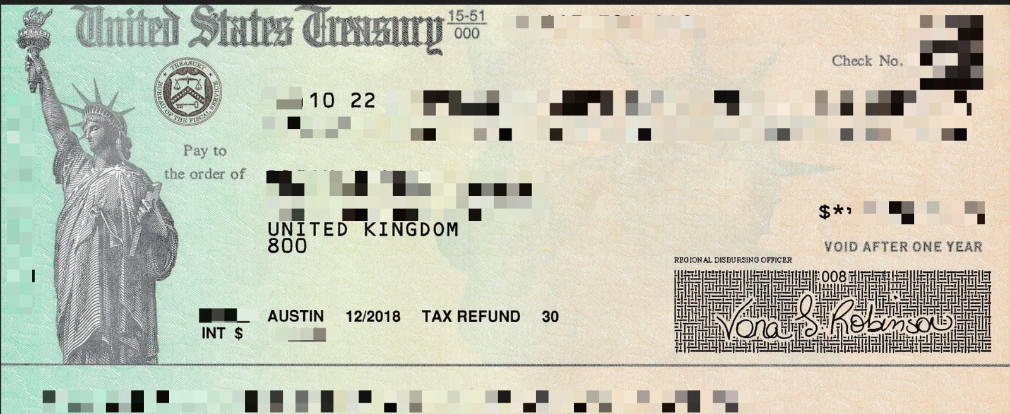
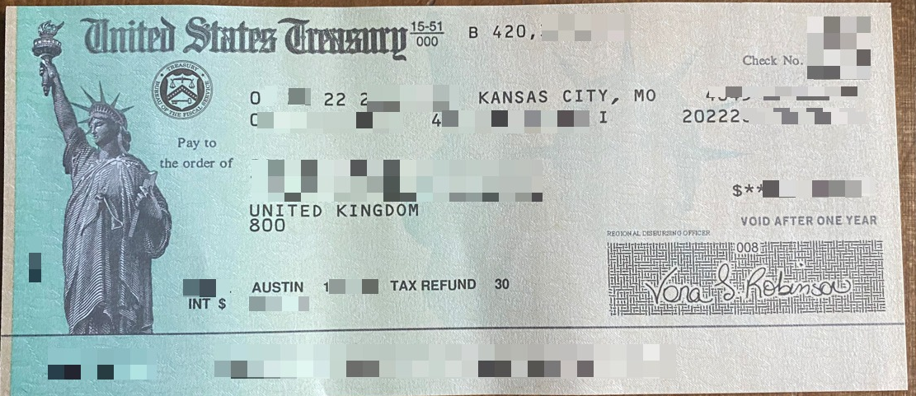
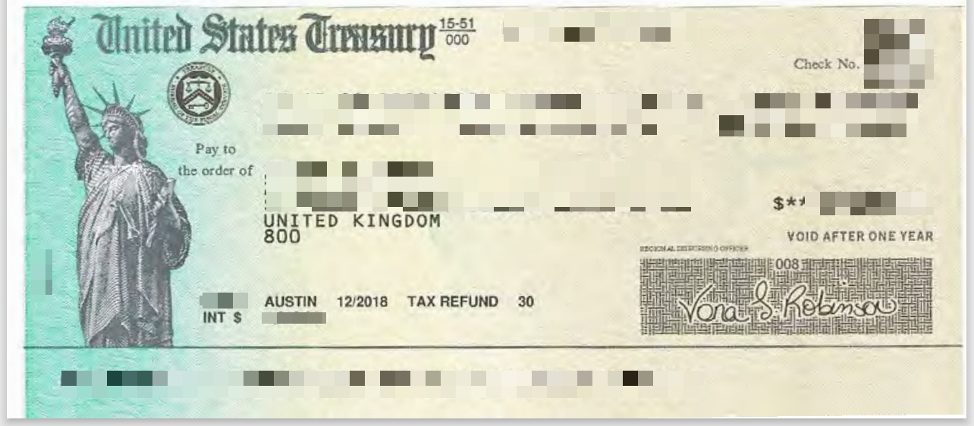
9. Recent success – the proof!

Slide 14
10. Expectations
Phase
Tasks
Timing
Donation
Phase 1
Pre-Qualification (advocacy)
1 – 2 weeks
+£1300
Phase 2
Financials & accounting
2- 3 weeks
£0
Phase 3
ID verify & file transfer to “Expert”
1 -2 weeks
£0
Phase 4
Tax return (cheque)
6 - 9 months
+13%

Slide 15

11. Rewards
WHO ELSE BENEFITS?
Returns to you (affiliate scheme)
Returns to the membership
Returns to your communities
Exchange of energy, energy flow
Notes:
Referral scheme, community projects, members have ownership/control

Slide 16
12. Getting started
Select the Benefit from the Club House
Donate the minimum donation required for your membership level
Complete the pre-qualification and NDA contract
One to one technical support

Slide 17


Questions?

Slide 18
Thank you for joining us on this journey!
Contact
Email: admin@empowerthepeople.earth
Tel: 0333 090 3881

